Slide 1

How did demographic
differences influence voting behaviour in the 2016 Brexit referendum?

Slide 2


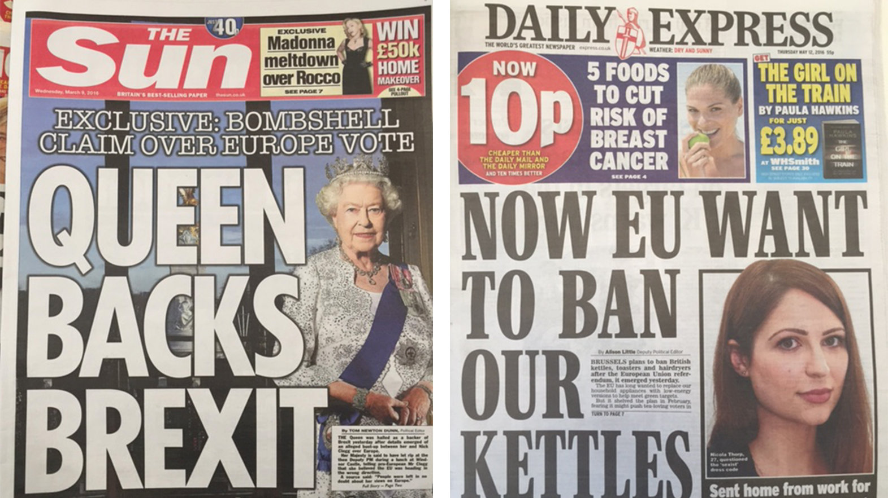

Slide 3
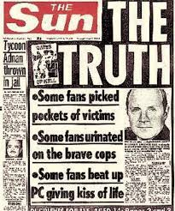

Slide 4

Hillsborough

Slide 5
Demographic factors:
Ethnic Diversity
Age
Level of education
Urbanicity
Votes in 2015 General Election

Slide 6
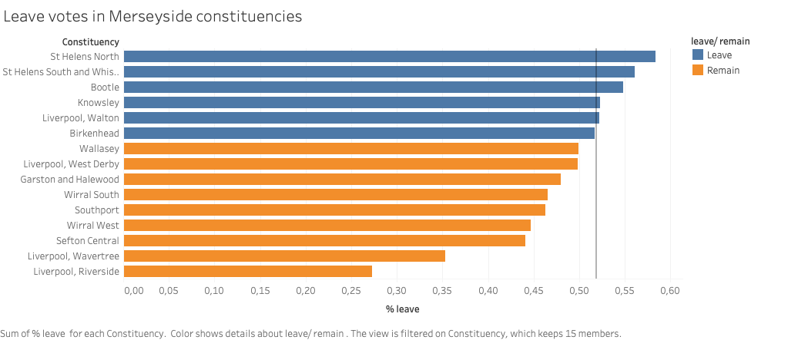

Slide 7
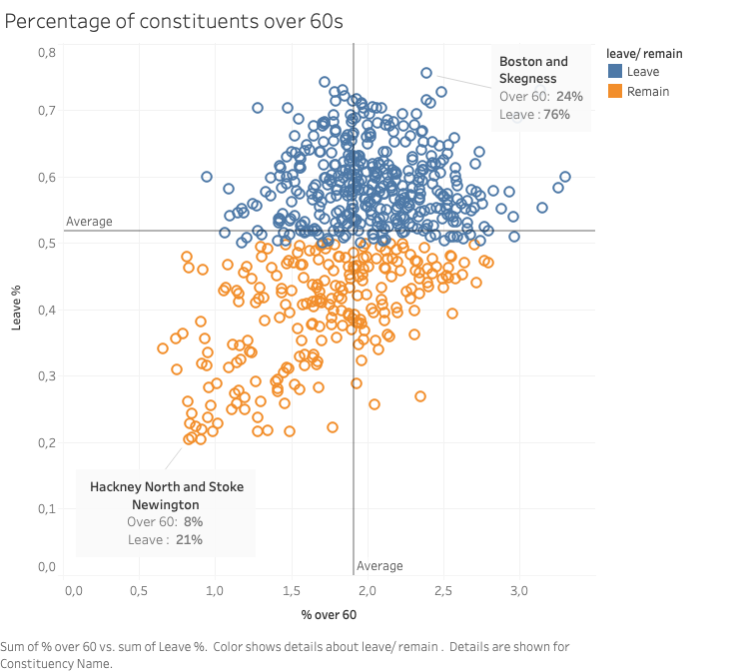

Slide 8
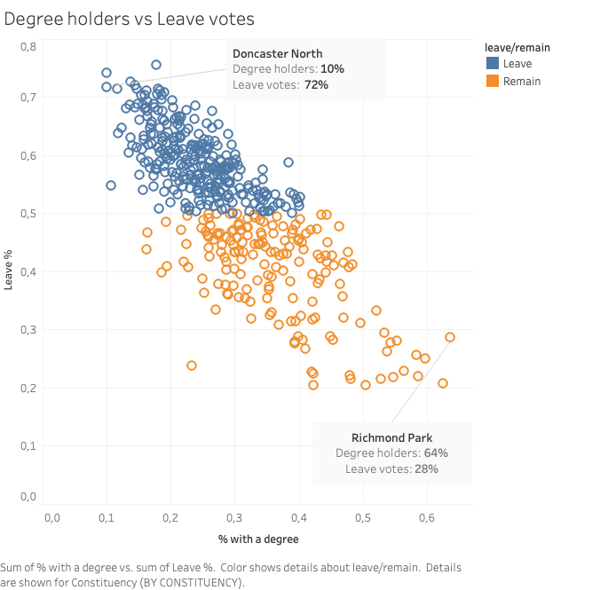

Slide 9
Expanding the analysis:
Test the general election - traditional Labour seats changing their allegiance

